Slide 1
Tesla Motors
“Persistence is very important. You should not give up unless you are forced to give up.”- Elon Musk
https://www.youtube.com/watch?v=k9zTr2MAFRg
https://www.youtube.com/watch?v=tRb6kQE7uYc

Slide 2
Learning objectives
The dynamics of competitive advantage due to learning and due to changes in factors such as scale and dynamic fulfillment of demand;
The dynamic fit between a firm’s strategic choices and its path over time;
CEO and its imprint on an organization;
Long term sustainability of a firm’s competitive advantage;
Corporate strategy, vertical integration and diversification strategy;
Global strategy

Slide 3
Case questions
What is your evaluation of Tesla’s market valuation?
What business model is Tesla pursuing? How does it differ from traditional car manufacturers?
How was Tesla able to enter into the auto industry?
What type of innovation strategy is Tesla pursuing?
What is the industry life cycle of the EV industry? What core competences are essential for each stage? Any strategic implications?

Slide 4
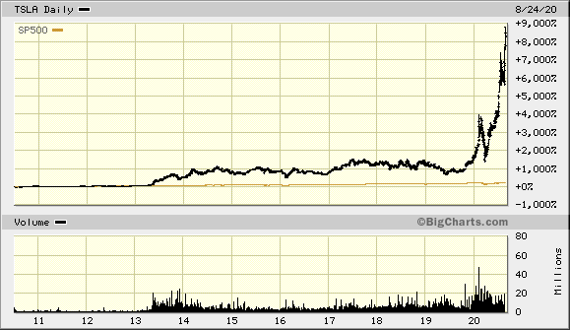
How is Tesla worth $375 billion?

Slide 5
The Christmas miracle!
2008, October (Discover), Elon Musk revealed that they have to cut almost 25% of its workforce, and analysts are wondering about its future. A number of investors withdraw their support or demand tougher terms as financial markets collapsed over the past month. With only $9 million on hand by the end of the year.
Article titled Christmas miracle that saved Tesla- “Even then, we only narrowly survived…we actually closed the financing round on Christmas Eve 2008. It was the last hour of the last day that it was possible”. Musk said.

Slide 6
2009, secured investment from Daimler for $50 million to acquire a stake in Tesla of under 10%.
$465 million loan from department of energy
IPO- $200 Million cash at $17/share
In 2013, Elon nearly sold Tesla to Google for $11 Billion
In 2018, Tesla faced a severe threat of death due to the Model 3 production ramp. “The company was bleeding money like crazy, and just if we didn’t solve these problems in a very short period of time we would die. “
Now Tesla becomes the most valuable car company in the world, greater market value than Ford, GM, and Fiat Chrysler put together.

Slide 7
 | General Motors | Tesla
Revenue | $137 billion | $25 billion
Net Income | $6.7 billion | ($862K)
Market Cap | $43 billion | $375 billion

Slide 8
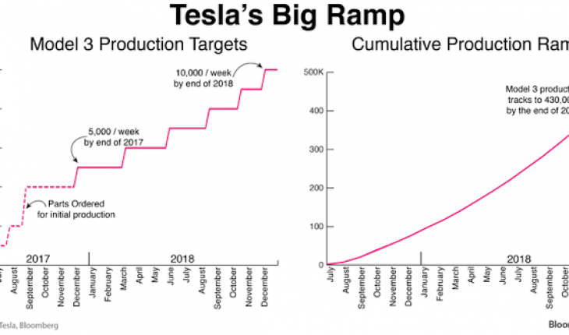

Slide 9
Why do people buy a Tesla?
How much do you save vs. purchasing a Prius or Accord?
If savings is minimal, then why do people buy? What’s driving WTP?

Slide 10
What is Tesla’s business model?
A business model- How firms make money is illustrated.
Direct-to-consumer sales via online
Low marketing expenses
Social network (network effect)
Software platform (connectivity among users)
Vehicle service model (much less service than traditional cars)
Open source innovation (share patents with 3rd party, accelerate the electrification process)

Slide 11
Getting to profitability
Economies of learning and Economies of scale will be crucial to lowering Tesla’s costs per unit, and thus enabling it to achieve profitability.

Slide 12
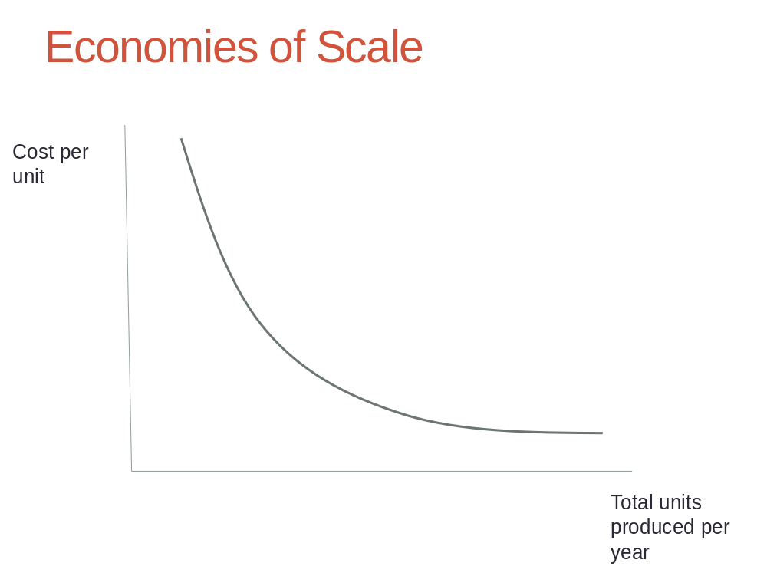

Slide 13
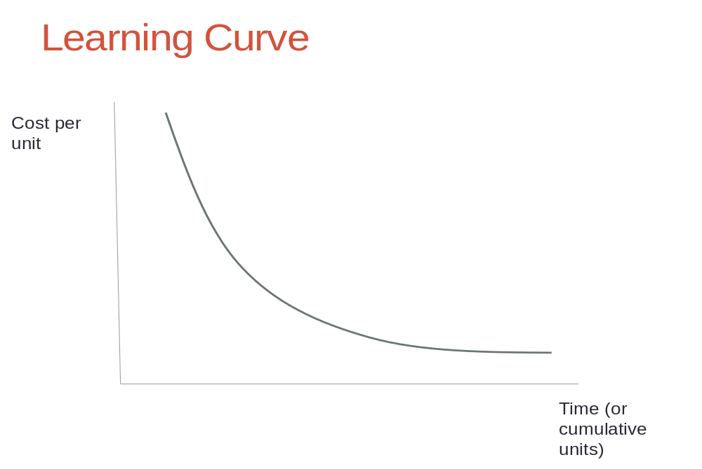

Slide 14
Overcoming Barriers to Entry
  Tons of startup capital required. Why?
    Product development is very expensive
    Distribution network hard to build (dealer network)
    Brand building and advertising is expensive
    Expensive to build manufacturing plant
    Have to provide service/support to customers throughout the country

Slide 15
Other barriers to entry in the auto industry
    Economies of scale and learning curve
    Some intellectual property barriers in terms of technology
    Some regulatory barriers
    Biggest issue with electric vehicles is acceptance of new technology, concern over range, and having enough charging stations for the EV cars to really take off in the marketplace

Slide 16
How did Tesla enter into the automotive market?
Electrification: develop a network supercharger to overcome range anxiety, and commercialize new technologies to overcome entry barriers.
Open innovation: cooperate with other players (Volvo, VW)
Autonomy: network of interconnected autonomous vehicles (18 billion miles of real-world driving, machine learning algorithms, AI network)

Slide 17
The decline of incumbent players (e.g., GM)

Slide 18
What are the major causes of strategic decline?
Imitation
  The auto companies all benchmarked each other, used reverse engineering, and copied each other relentlessly. Lots of herd behavior in the industry in terms of design and engineering
  Hard to maintain any type of proprietary advantage in terms of technology or design
Substitution
  Hybrids, electric vehicles, self-driving cars, Uber are all substitutes. Most of these are threats moving forward… don’t explain GM’s decline.

Slide 19
Holdup
  HUGE issue for GM and Chrysler!
  Supplier power – enormous! Labor unions extracted a ton of value over the years.
  Buyer power – also substantial – the dealer network had a lot of power. Moreover, buyers proved not to be brand loyal. They defected to imports such as Honda and Toyota when those proved to have higher quality.
Internal sources of decline
  Mentality, complacency, culture, bureaucracy – so hard to change! Great material here for discussion of how culture can eat strategy for lunch!

Slide 20
How can Tesla build barriers to imitation?
  Get down the learning curve quickly
  Make good tradeoffs
  Continue to build brand loyalty and switching costs

Slide 21
Key lessons and takeaways
What drives market value of a firm?
Dynamics of strategy – learning curves, scale economies
How to overcome barriers to entry?
Why incumbents lose their advantage?
First mover advantage vs. fast followers
Network effects

